Slide 1
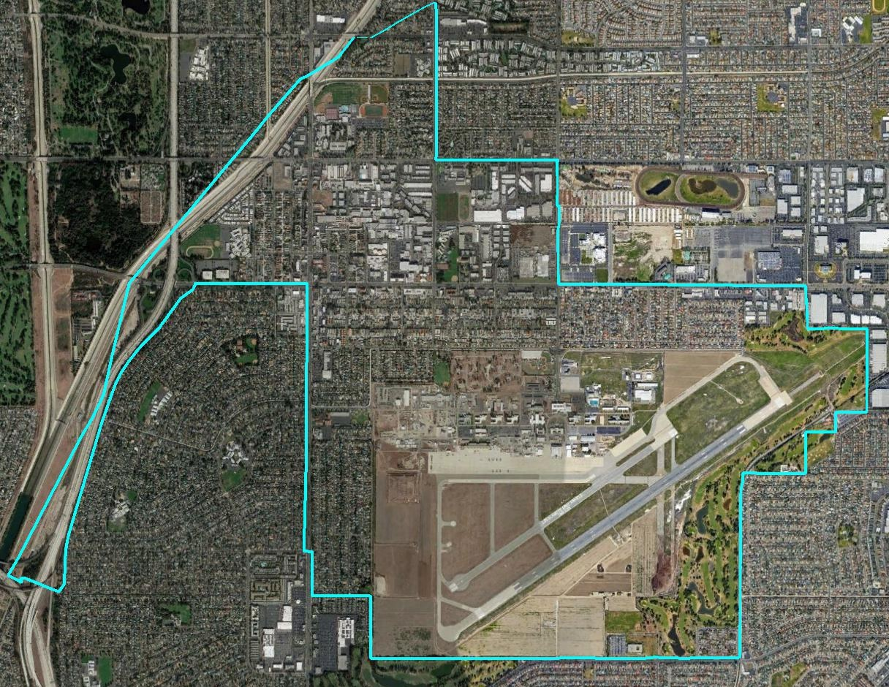
City of Los Alamitos
Districting 2018
Dr. Justin Levitt, Vice President, NDC

Slide 2
Election Systems
“At Large”
“From District” or “Residence” Districts
“By District”
The California Voting Rights Act was written to specifically require by-district elections.

Slide 3
Project Timeline
Date | Event
May 29 | 1st hearing to gather input on the composition of districts
June 4 | 2nd hearing to gather input on the composition of districts
June 11 at the latest | Draft maps posted on City website and available at City Hall
June 18 | 3rd hearing: public input on draft maps and election sequencing (5 pm)
July 9 | 4th hearing: public input on draft maps and election sequencing Possible map selection and First Reading
July 16 | 5th hearing: Map selection and adoption
Nov. 2020 | First by-district elections in two zones
Nov. 2022 | First by-district elections in remaining three zones
2021 | Districts redrawn to reflect 2020 Census data

Slide 4
CVRA Impact
Switched (or in the process of switching) as a result of CVRA:
  At least 165 school districts
  30 Community College Districts
  90 cities
  1 County Board of Supervisors
  8 water and other special districts.
Key decisions & settlements
  Only Palmdale has gone to trial on the merits (the city lost)
  Key settlements:
    Palmdale: $4.7 million
    Modesto: $3 million
    Anaheim: $1.1 million
    Whittier: $1 million
    Santa Barbara: $600,000
    Tulare Hospital: $500,000
    Madera Unified: about $170,000
    Hanford Joint Union Schools: $118,000
    Merced City: $42,000
    Placentia: $20,000

Slide 5
Demographic & Election Review

Slide 6
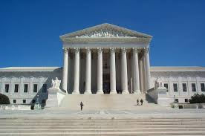
Traditional Districting Criteria
Federal Laws
Traditional Criteria
Equal Population
Federal Voting Rights Act
No Racial Gerrymandering
Communities of interest
Compact
Contiguous
Visible (Natural & man-made) boundaries
Planned future growth/ Growth since 2010
Respect for voters’ wishes and continuity in office

Slide 7

Defining Communities of Interest
1st Question: what is your neighborhood or community of interest?
A Community of Interest is generally defined as a neighborhood or community of shared interests, views, problems, or characteristics. Possible community feature/boundary definitions include:
School attendance areas
Natural neighborhood dividing lines, such as highway or major roads, rivers, canals, and/or hills
Areas around parks and other neighborhood landmarks
Common issues, neighborhood activities, or legislative/election concerns
Shared demographic characteristics
  Such as similar levels of income, education, or linguistic isolation
2nd Question: Does a Community of Interest want to be united in one district, or to be divided to have a voice in multiple elections?

Slide 8
Demographic Summary
Latinos are 21% of the total population and 19% of the eligible voters (measured by Citizen Voting Age Population data).
Asian-Americans are 14% of total population and 13% of eligible voters.
African-Americans are 3% of total population and 6% of eligible voters.

Slide 9
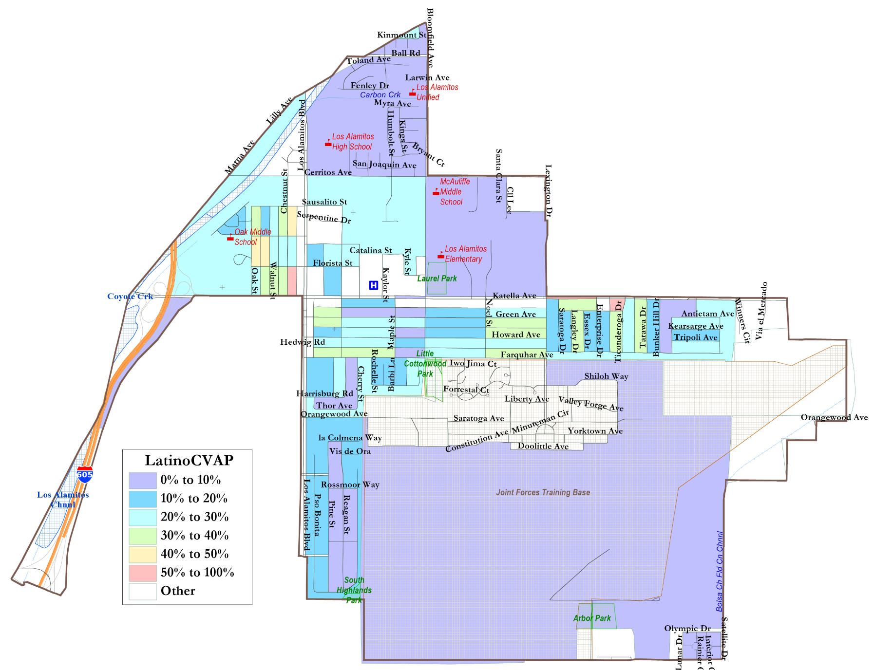
Latino Percentage of Eligible Voters
Latinos are somewhat more concentrated along the middle of the city and around Los Alamitos High School, but Latinos are only a majority in two small census blocks (shown in red).

Slide 10
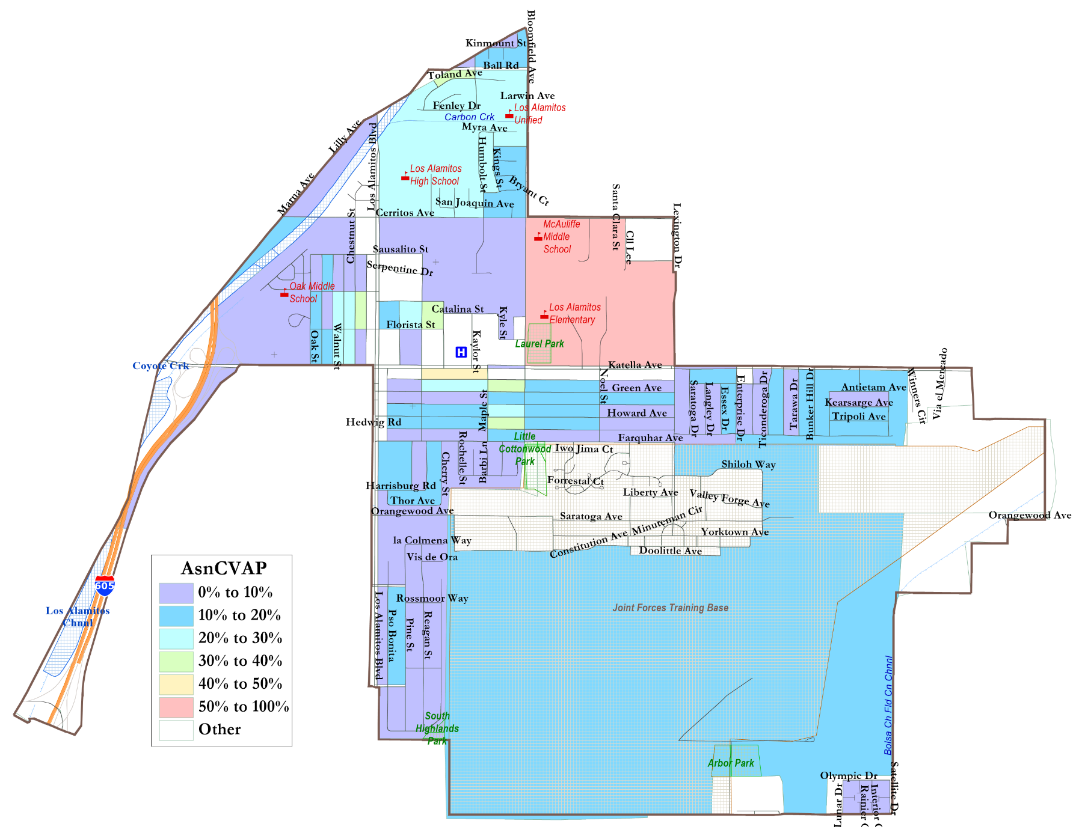
Asian-Amer. Eligible Voters
Asian-Americans are concentrated in the 85-person Census Block around the middle and elementary schools and a few blocks southwest of Los Alamitos Elementary.

Slide 11
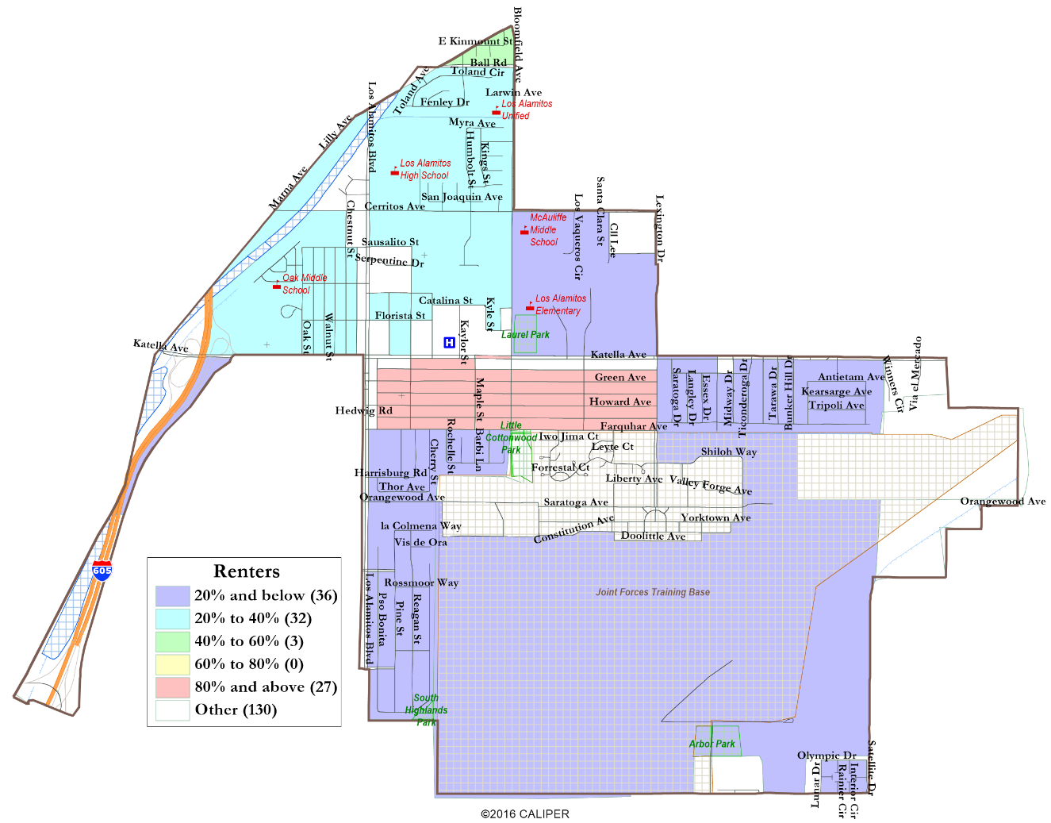
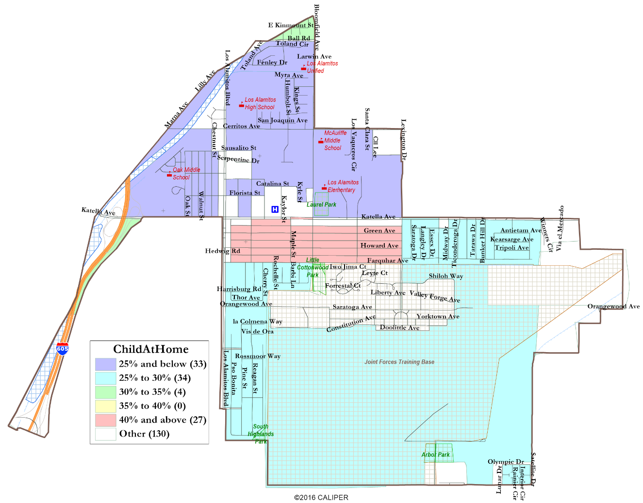
Other Demographics
ACS Socio-Economic Data are available at the less-precise Census Tract level.

Slide 12
Discussion & Questions
What is your neighborhood or “community of interest”?
Do you prefer your neighborhood be kept together in one district or have multiple representatives?
What are other communities of interest in the City that should be considered when drafting maps?

