Slide 1
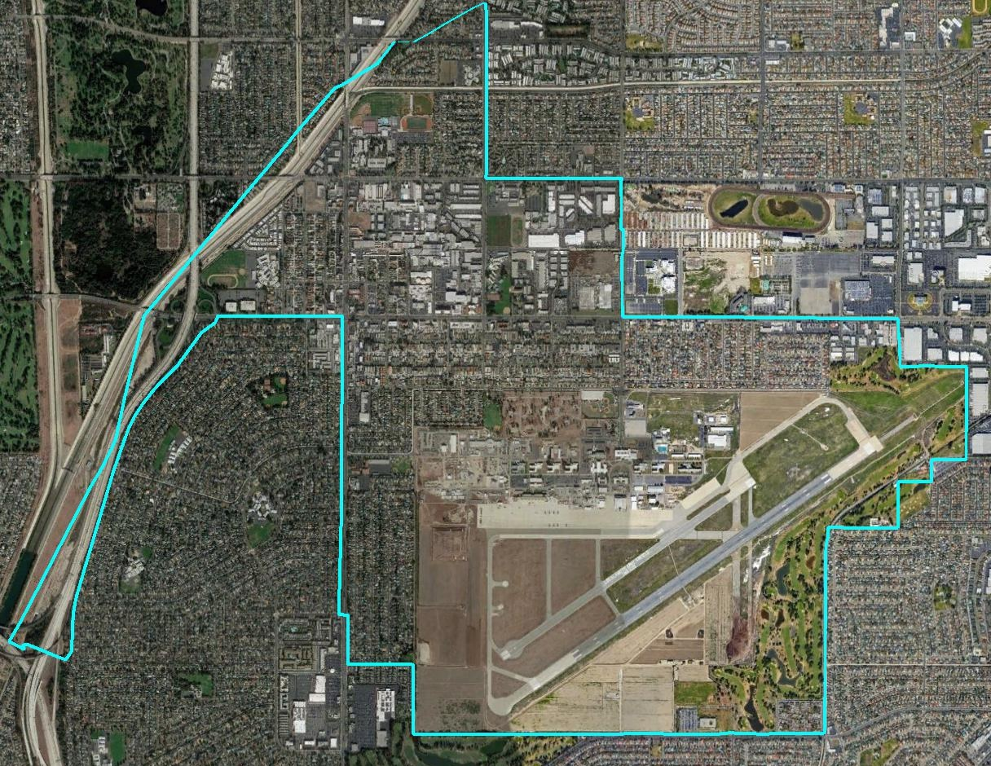
City of Los Alamitos Districting 2018
Dr. Douglas Johnson, President, NDC

Slide 2
Project Timeline
Date | Event
May 29 | 1st hearing to gather input on the composition of districts
June 4 | 2nd hearing to gather input on the composition of districts
June 11 at the latest | Draft maps posted on City website and available at City Hall
June 18 | 3rd hearing: public input on draft maps and election sequencing (5 pm)
July 9 | 4th hearing: public input on draft maps, election sequencing, and possible map selection
July 16 | 5th hearing: Map selection and first reading
August 20 | Adoption of Map by Ordinance
Nov. 2020 | First by-district elections in two districts
Nov. 2022 | First by-district elections in remaining three districts
2021 | Districts redrawn to reflect 2020 Census data

Slide 3
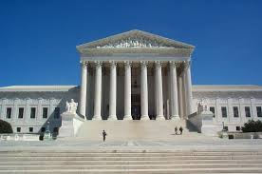
Traditional Districting Criteria
Federal Laws
Traditional Criteria
Equal Population
Federal Voting Rights Act
No Racial Gerrymandering
Communities of interest
Compact
Contiguous
Visible (Natural & man-made) boundaries
Planned future growth/ Growth since 2010
Respect for voters’ wishes and continuity in office

Slide 4
Draft Maps
Each of the following maps is population-balanced
These maps can be reviewed in much more detail using the interactive map viewer, available online at this link.
Visit http://cityoflosalamitos.org/district-elections/ for more information.

Slide 5
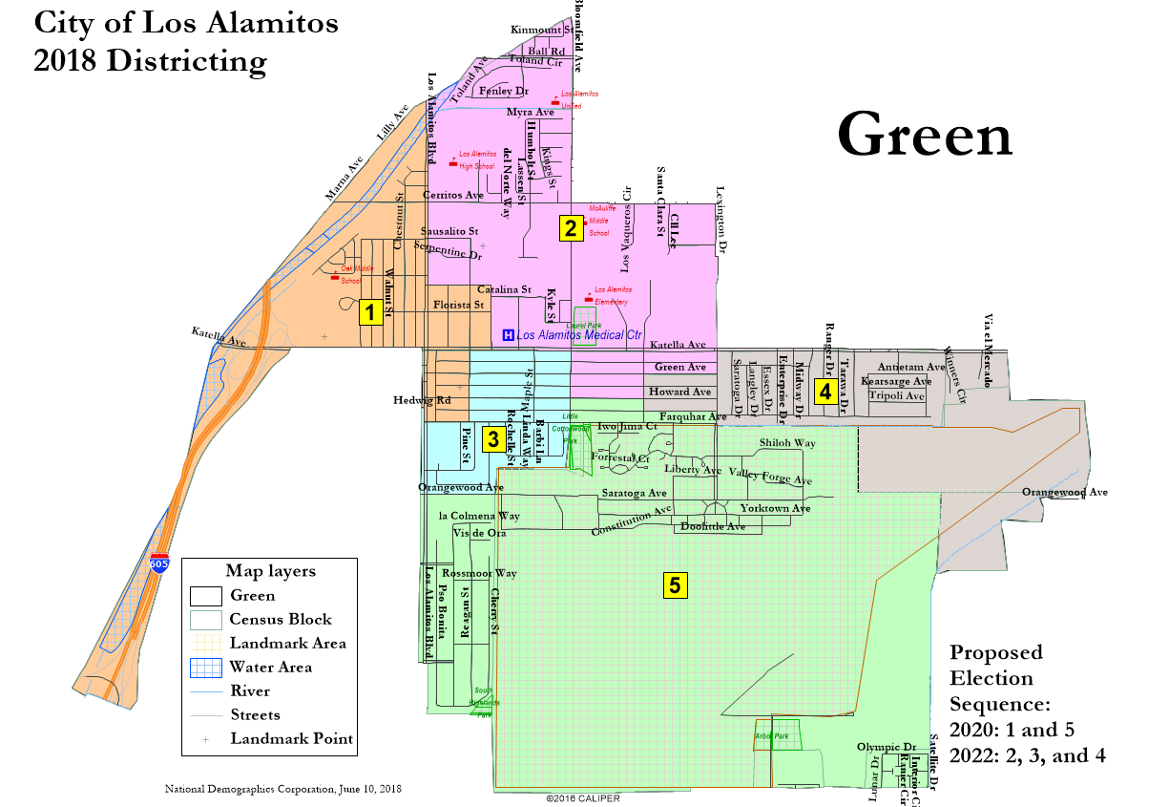
NDC Green Map

Slide 6
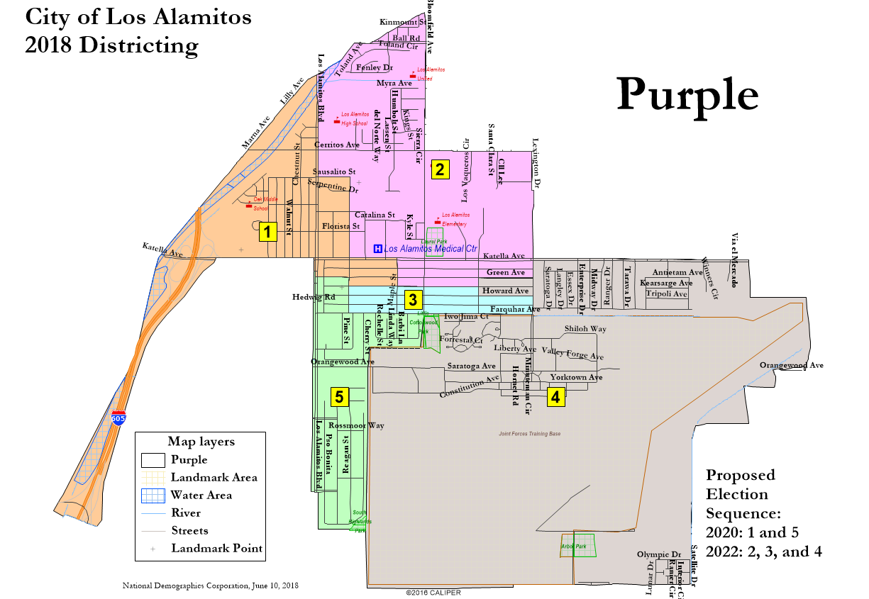
NDC Purple Map

Slide 7
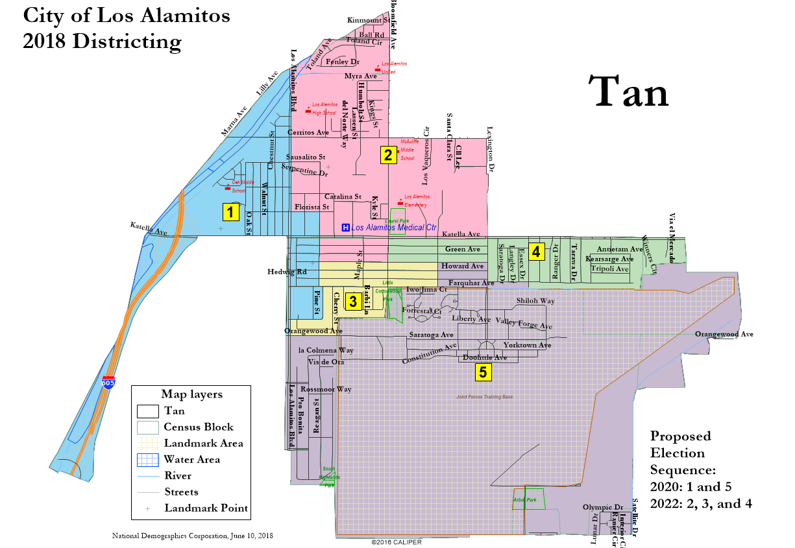
NDC Tan Map

Slide 8
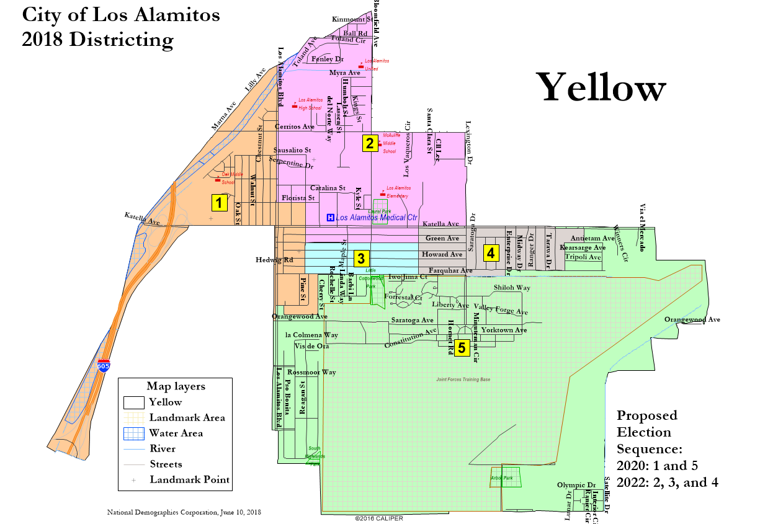
NDC Yellow Map

Slide 9
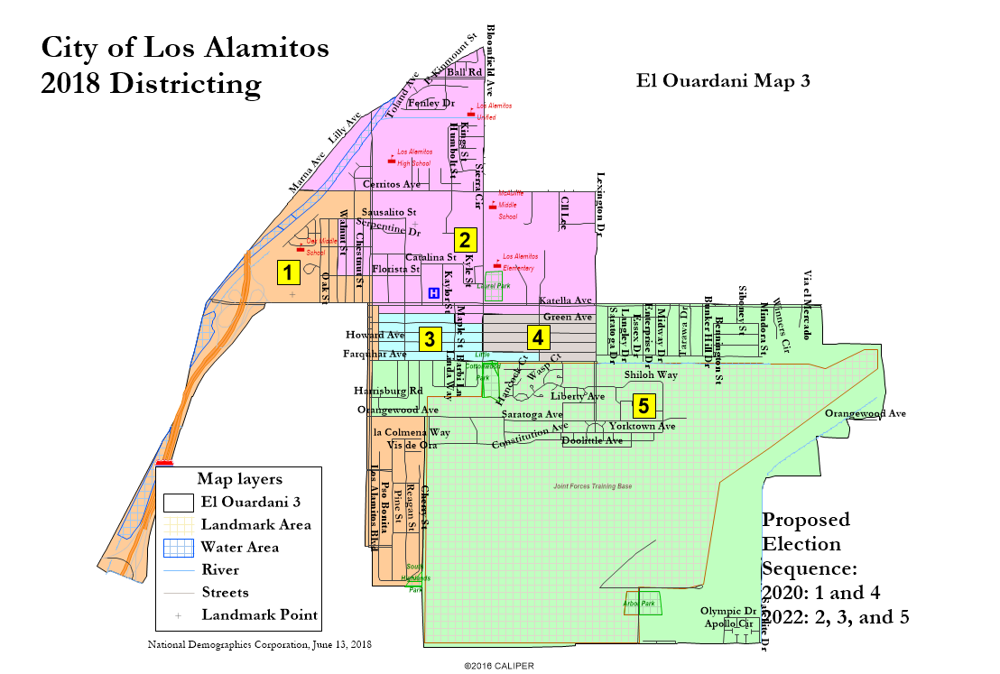
El Ouardani Map 3

Slide 10
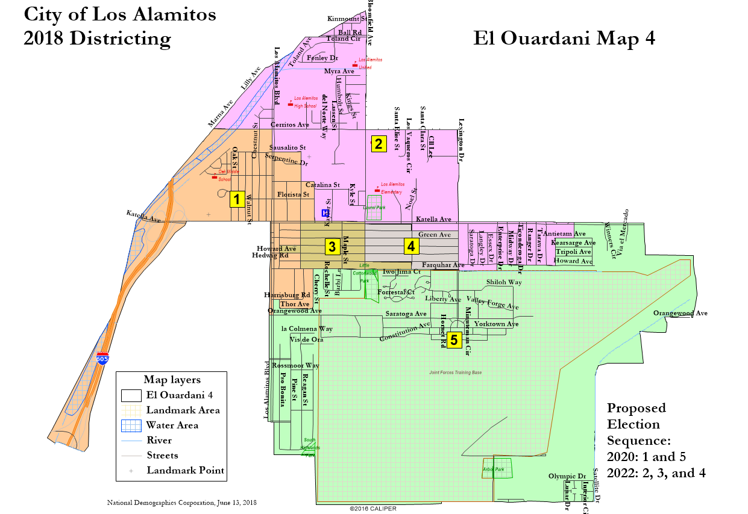
El Ouardani Map 4

Slide 11
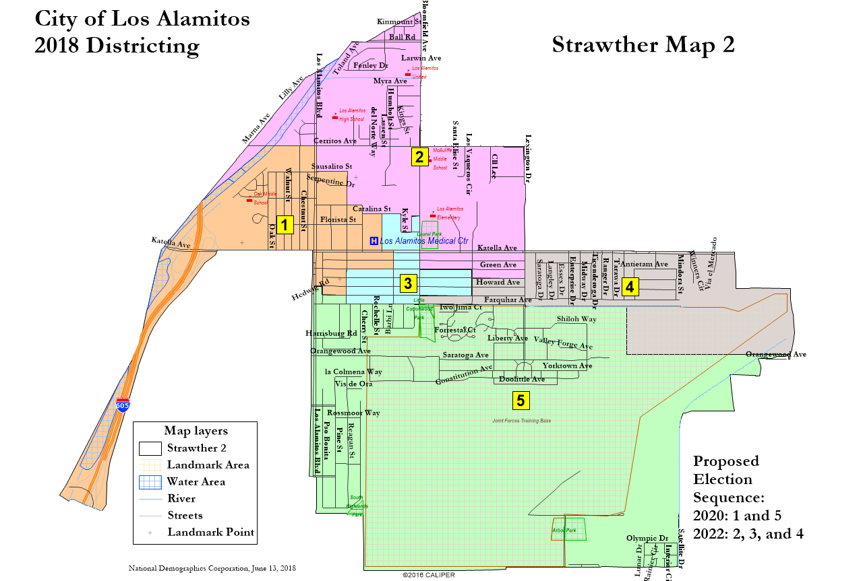
Strawther Map 2

Slide 12
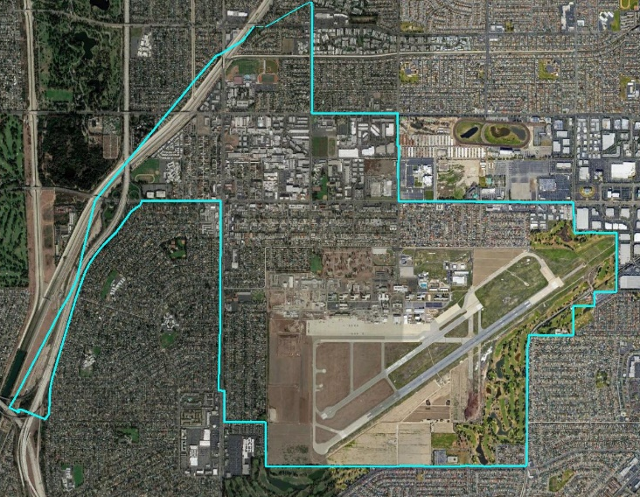
Discussion
4-District demonstration map also included in agenda packet.
What do you like or dislike about each map?
What map is best for your “community of interest” or neighborhood?

